Slide 1


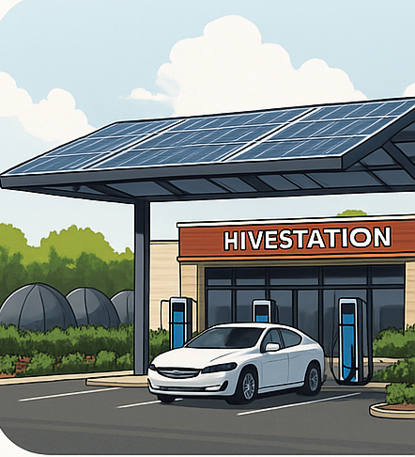
HIVE
HIVE
EV Power Station
OFF-GRID EV CHARGING & CLEAN RETAIL. ANYWHERE
Scalable pilot begins in Round Rock, TX

Slide 2
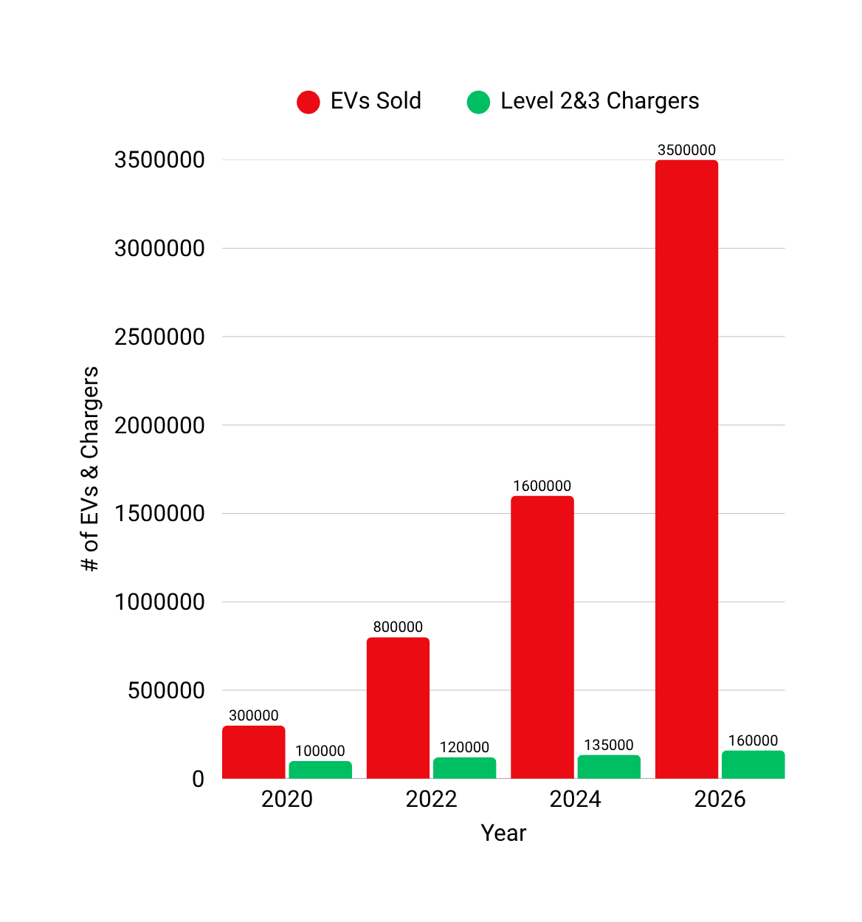
EVS ARE OUTPACING INFRASTRUCTURE
EV ownership is booming but infrastructure is lagging
Over 40% of U.S. counties have zero level 3 chargers
Nearly all public chargers are tied directly to the grid
SOURCE: IEA, DOE, EVADOPTION.COM

Slide 3
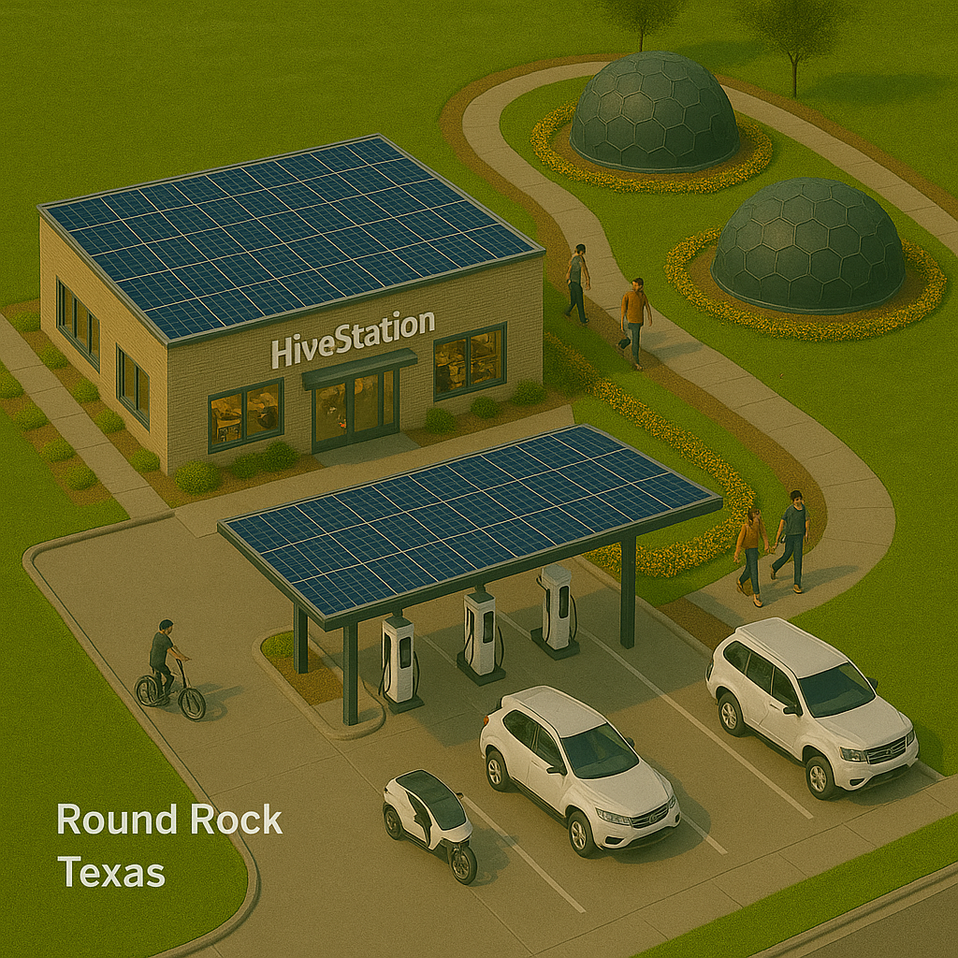
SOLUTION:
THE
HIVE POWER
STATION
Off-grid EV charging
combines solar, kinetic, and battery energies
services 150-200 EVs daily
NO grid hookup
Competitive Advantage:
No other EV charging company offers off-grid energy + retail + swap logic under $1M per site.”

Slide 4
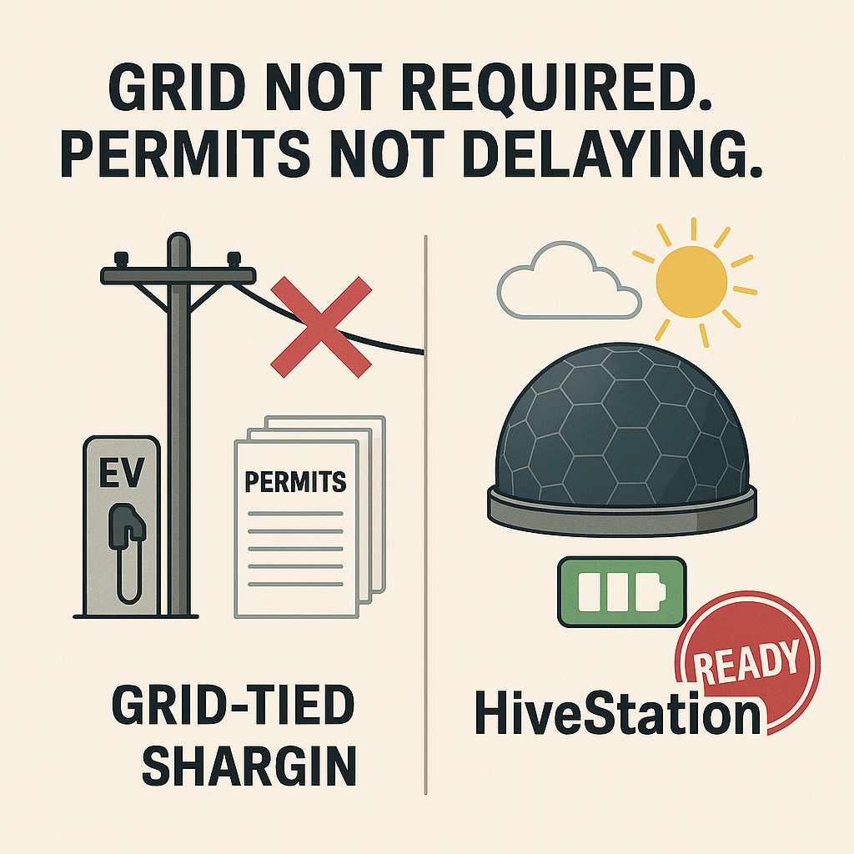
Why now?
EV demand is growing 3x faster than charging
Traditional EV sites cost $1 - $2M just to install charger and they are still tied to the grid
Texas alone is receiving $407M in funding to deploy charging solutions but lacks agile, off-grid partners

Slide 5
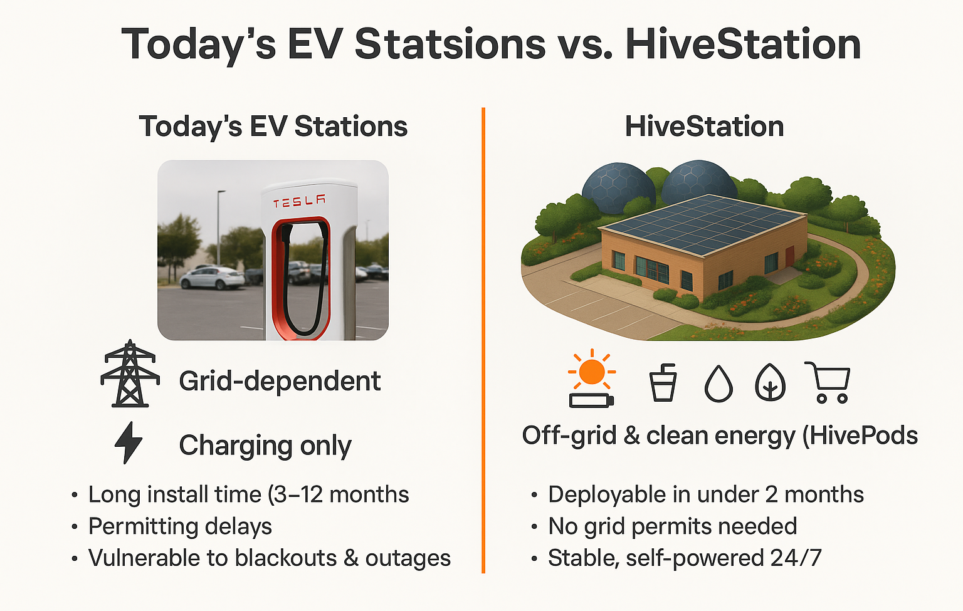

Today’s EV Stations vs. Hive Power Stations
CURRENT VS HIVESTATION
Hive Power Station
Traditional EV
Grid dependent
High utility and maintenance costs
Long permitting delays
HiveStation
Self-powered, Solar-integrated
4+ income streams
NO utility bills

Slide 6
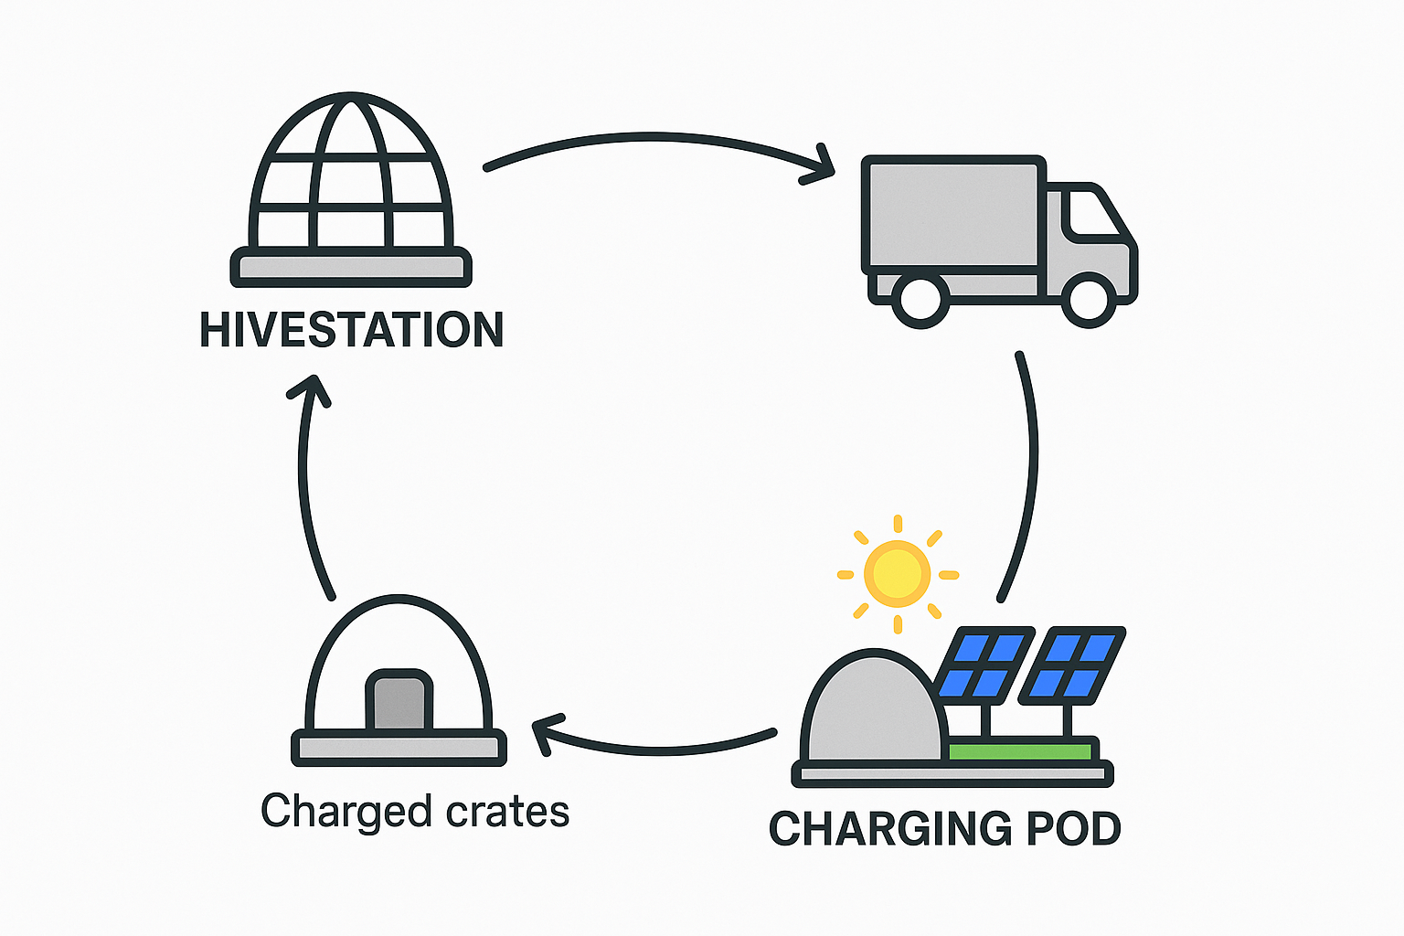
OPPORTUNITY
EV sales are growing 35% YoY vs. only 10% charger growth.
No utility hookup required = HiveStation can reach markets others can’t - tapping into a $300B global EV infrastructure market.
Brings fast EV charging to the counties without it

Slide 7
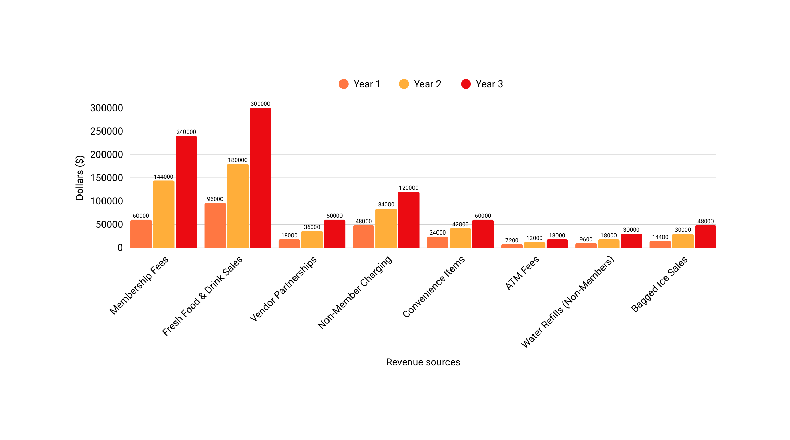
REVENUE
vendor partnerships for shelving and coolers
ATM
Membership fees
Non-member charging pay-per-kWh
Breakeven = 2.5 - 3 yrs
ROI = < 3 years
fresh made drinks and food sales
convenience items
water gallon refills (free for members)
Bagged ice

Slide 8




Investor return options
Profit sharing - annual share of net profits
Buyback option - guaranteed 2-4x return in 4-5 years
Royalty model - % of revenue until target return
Equity retention - Long term value as brand grows

Slide 9
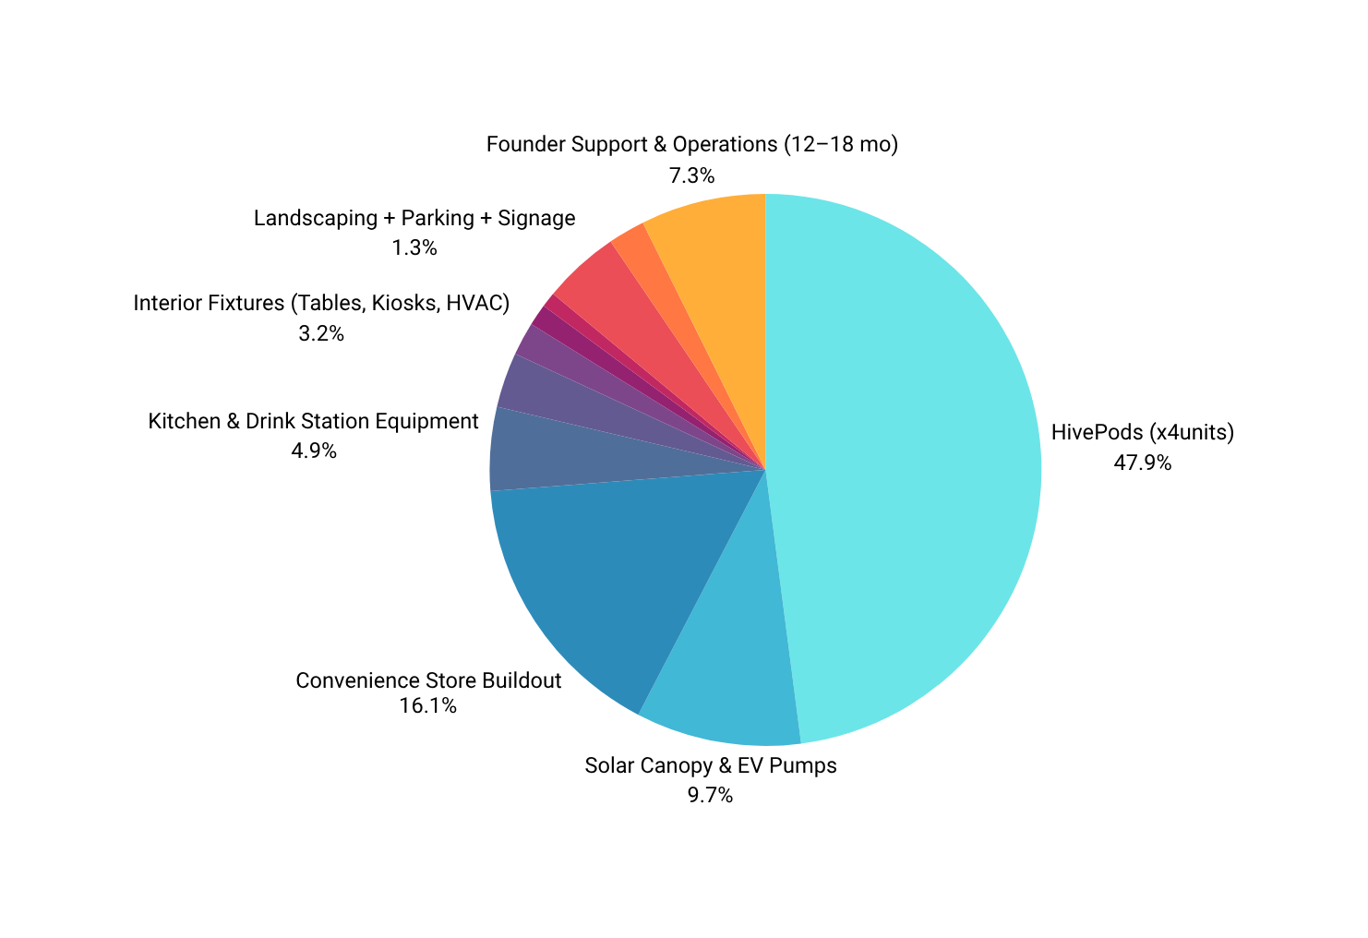
COST BREAKDOWN
Hivepods (x4) - $444,172
Solar Canopy & EV Pumps -$90,000
Convenience Store Buildout - $150,000
Kitchen & Drink Station Equipment- $45,000
Interior Fixtures (Tables, Kiosks, HVAC) - $30,000
Wells + Water/Ice System- $18,000
Landscaping + Parking + Signage - $12,000
Security & Surveillance + Access System- $8,000
Labor (Site Prep, Install, Testing)- $42,000
Total Build Cost:
$927,172
Total time to build:
Best: 5-6 months
Realistic: 6-7 months
Worse: 8-9 months

Slide 10

Key Hires
TEAM AND
PARTNERS
BMS Firmware developer
Electrical systems engineer
Construction project manager
Permitting consultant
Founder & CEO:
Kashawn Coleman
military veteran, system planner, technical founder
PROOF OF TRACTION:
Hivepod BOM (build of materials)
Cost model
Site layout & location
Curated partner list

Slide 11
Hive Timeline (months)
1
2
3
4
5
6
Finalize construction & launch
Begin Hivepod prototyping & BMS firmware
Site Grading + Solar Mount Prep
Build structure & layout
Install equipment, & stock
Secure vendor, land and finalize key components

Slide 12

Ask/return:
$750K=15.8% equity + your choice of return path
Funding goals:
Finalize pod prototype, secure land, prepare rollout.
Timeline:
Pilot ready in 6 months
Key milestone:
First revenue in 9–12 months
Join the Journey

